Slide 1


Insert relevant picture related to the topic
ALGORITHMS AND DATA STRUCTURES
TEB1113/TFB2023
WEEK Vb
QUEUE
FARAHIDA HANIM BT MAUSOR - DR (FSMC/UTP)
BACHELOR OF XXXXXX
DEPARTMENT OF COMPUTING
FACULTY OF SCIENCE, MANAGEMENT & COMPUTING
© 2026 INSTITUTE OF TECHNOLOGY PETRONAS SDN BHD
All rights reserved. No part of this document may be reproduced, stored in a retrieval system or transmitted in any form or by any means (electronic, mechanical, photocopying, recording or otherwise) without the permission of the copyright owner.

Slide 2
RECAP FROM PREVIOUS LECTURE
A stack is a linear ADT.
Stack follows LIFO: Last In, First Out.
push() inserts at the top.
pop() removes from the top.
Stack can be implemented using arrays or linked lists.
Notes:
Learning Outcomes Slide
Note:
Include 2–4 lecture-level learning outcomes
Use measurable action verbs
Map explicitly to Course Learning Outcomes (CLOs)

Slide 3
LEARNING OUTCOMES
Explain Queue as a First-In-First-Out ADT.
Trace enqueue() and dequeue() operations using front and rear pointers.
Implement queues using arrays and linked lists in C++.
Differentiate linear, circular, and priority queues.
Notes:
Learning Outcomes Slide
Note:
Include 2–4 lecture-level learning outcomes
Use measurable action verbs
Map explicitly to Course Learning Outcomes (CLOs)

Slide 4
TOPICS
Queue Concept and FIFO Rule
Front and Rear Pointers
Queue Operations
Array and Linked-List Implementation
Circular Queue
Priority Queue
Notes:
Learning Outcomes Slide
Note:
Include 2–4 lecture-level learning outcomes
Use measurable action verbs
Map explicitly to Course Learning Outcomes (CLOs)

Slide 5
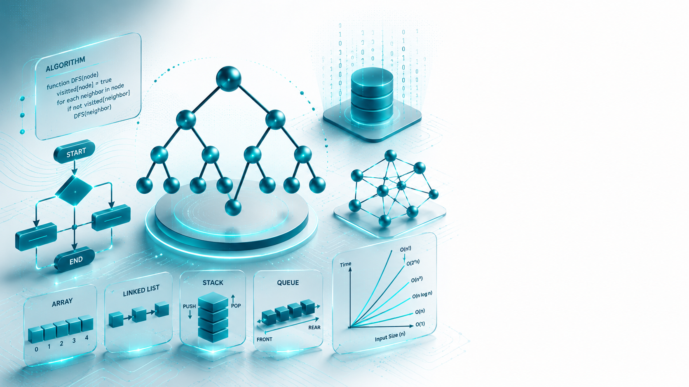
QUEUE
Introduction

Slide 6
INTRODUCTION
1.1. BRIEF THEORY
A queue is a linear data structure. It's an ordered list that follows the FIFO principle (First In - First Out).
A queue is a structure that has some insertion and deletion constraints. In the case of a Queue, insertion is done from one end, which is referred to as the rear end.
The deletion is carried out by another end, which is referred to as a front end. The technical terminology for insertion and deletion in a Queue is 𝐸𝑛𝑞𝑢𝑒𝑢𝑒 () and 𝐷𝑒𝑞𝑢𝑒𝑢𝑒 (), respectively.
It has two pointers in its structure: a 𝐹𝑟𝑜𝑛𝑡 pointer and 𝑟𝑒𝑎𝑟 pointer, element will be added using a rear pointer and will be deleted using a front pointer.
Notes:
Engagement and Activity Slides
Note:
Include at least one engagement element where appropriate:
Think–Pair–Share
Mini task
Poll or reflection question
Suggested duration: 3–5 minutes
Activities shall align with learning outcomes

Slide 7
INTRODUCTION
1.1. OPERATIONS IN QUEUE
𝐶𝑟𝑒𝑎𝑡𝑒 𝑸: It creates an empty queue, Q.
𝐸𝑛q𝑢𝑒𝑢𝑒 𝑸, 𝑖𝑡𝑒𝑚∶ Adds the element item to the rear of a queue and returns the new queue. The complexity of the enqueue operation is O (1).
𝐷𝑒q𝑢𝑒𝑢𝑒 𝑸∶ Returns the older element of the queue.
Queues can be implemented in two ways:
using an array data structure.
Using a linked list data structure.
Notes:
Engagement and Activity Slides
Note:
Include at least one engagement element where appropriate:
Think–Pair–Share
Mini task
Poll or reflection question
Suggested duration: 3–5 minutes
Activities shall align with learning outcomes

Slide 8
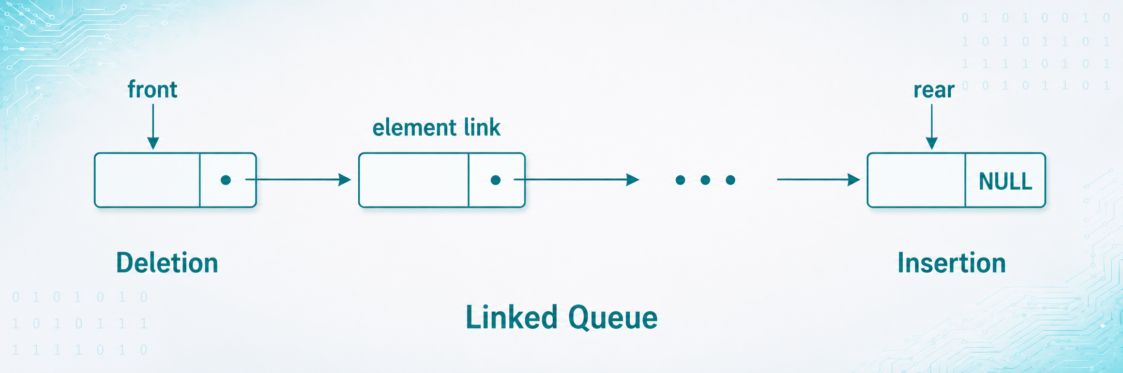
INTRODUCTION
1.1. STRUCTURE OF QUEUE
Notes:
Engagement and Activity Slides
Note:
Include at least one engagement element where appropriate:
Think–Pair–Share
Mini task
Poll or reflection question
Suggested duration: 3–5 minutes
Activities shall align with learning outcomes

Slide 9
INTRODUCTION
1.1. BRIEF THEORY (CIRCULAR QUEUE)
There is a limitation in the array implementation of the Queue. If the rear reaches the end position of the Queue, then there might be a possibility that some vacant spaces are left in the beginning, which cannot be utilized. So, to overcome those limitations, the concept of the circular queue was introduced.
A circular queue is like a linear queue as it is also based on the FIFO (First in First Out) principle, except that the last position is connected to the first position in a circular queue that forms a circle. It is also known as a Ring Buffer. A modular function is used to implement 𝐸𝑛𝑞𝑢𝑒𝑢𝑒 and 𝐷𝑒𝑞𝑢𝑒 operation in a circular queue.
Notes:
Engagement and Activity Slides
Note:
Include at least one engagement element where appropriate:
Think–Pair–Share
Mini task
Poll or reflection question
Suggested duration: 3–5 minutes
Activities shall align with learning outcomes

Slide 10
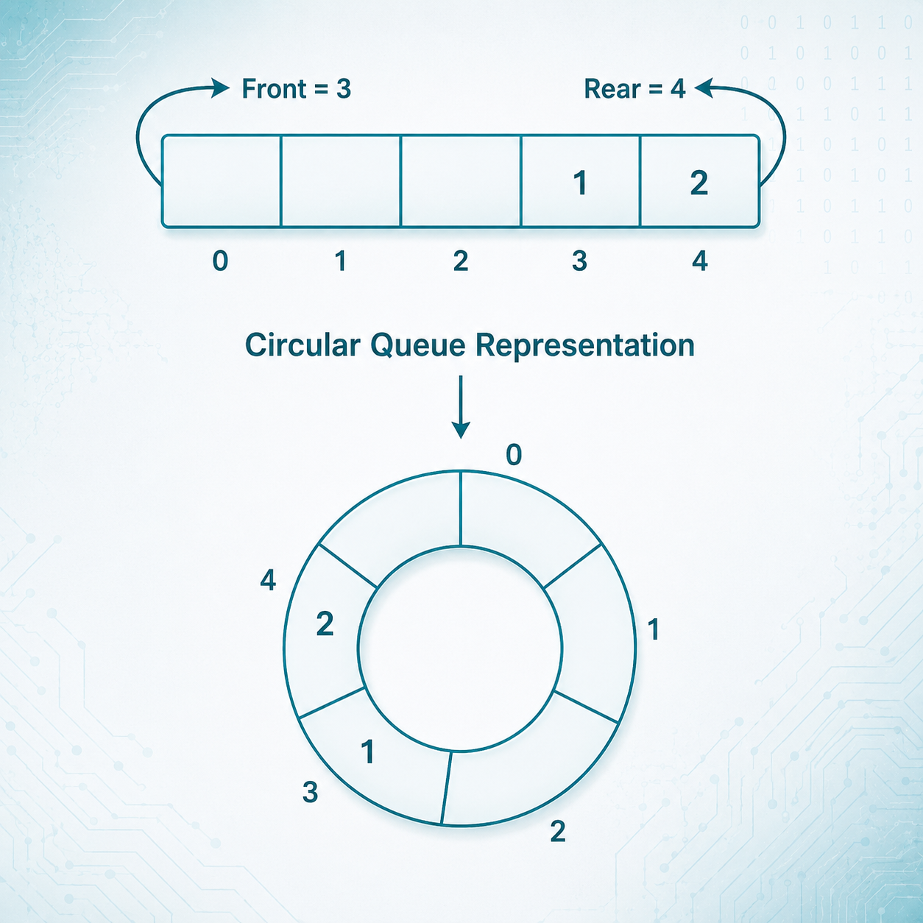
INTRODUCTION
1.1. STRUCTURE OF CIRCULAR QUEUE
Notes:
Engagement and Activity Slides
Note:
Include at least one engagement element where appropriate:
Think–Pair–Share
Mini task
Poll or reflection question
Suggested duration: 3–5 minutes
Activities shall align with learning outcomes

Slide 11
SUMMARY
TODAY’S KEY TAKEAWAYS:
A queue follows FIFO: First In, First Out.
enqueue() inserts an item at the rear.
dequeue() removes an item from the front.
Queues can be implemented using arrays or linked lists.
Circular queues use modulo arithmetic to reuse empty array spaces.
Priority queues process items based on priority.
Notes:
Engagement and Activity Slides
Note:
Include at least one engagement element where appropriate:
Think–Pair–Share
Mini task
Poll or reflection question
Suggested duration: 3–5 minutes
Activities shall align with learning outcomes

Slide 12
LAB TASK
CREATE A C++ PROGRAM
Part A: Array-Based Queue
push()
pop()
peek()
isFull()
isEmpty()
display()
Part B: Linked-List Queue
push()
pop()
peek()
isFull()
isEmpty()
display()
Notes:
Engagement and Activity Slides
Note:
Include at least one engagement element where appropriate:
Think–Pair–Share
Mini task
Poll or reflection question
Suggested duration: 3–5 minutes
Activities shall align with learning outcomes

Slide 13
SUMMARY
By the end of this session:
A queue is a linear data structure that operates strictly on the First In - First Out (FIFO) principle.
Insertion is performed at the rear end via the Enqueue() operation (O(1) complexity), while deletion happens at the front end via the Dequeue() operation.
Queues can be structurally implemented using either a standard array or a linked list data structure.
Circular queues (or ring buffers) connect the last position back to the first using modular arithmetic to prevent vacant array spaces from being wasted
Priority queues process elements based on assigned urgency rather than arrival order, defaulting to FIFO rules only when priorities are equal.
The practical lab work requires coding both array and linked list queues from scratch and analyzing problems within circular queue array implementations
Notes:
Summary and Closure Slides
Note:
Summarise 3–5 key takeaways
Reinforce main ideas
Indicate CLO coverage where appropriate
Include:
Upcoming topics
Required reading
Tutorial / lab / assessment linkage

Slide 14
LAB TASK
Creation of a Queue using an array and then implementation of 𝐸𝑛𝑞𝑢𝑒𝑢𝑒 and 𝐷𝑒𝑞𝑢𝑒𝑢𝑒 operations.
Creation of a Queue using Linked List and then implementation of 𝐸𝑛𝑞𝑢𝑒𝑢𝑒 and 𝐷𝑒𝑞𝑢𝑒𝑢𝑒 operations.

Slide 15

THANK YOU
FARAHIDA HANIM BT MAUSOR - DR (FSMC/UTP)
DEPARTMENT OF COMPUTING
farahida.mausor@utp.edu.my
02-03-26

